Slide 1
Model Assessment

Slide 2
Model Assessment
There is a need to determine how good your ML model is.
Regression:
Coefficient of determination (the R-squared measure of goodness of fit);
Lack-of-fit sum of squares;
Reduced chi-squared
Regression validation
Classification:
Pearson's chi-squared test
Confusion matrices

Slide 3
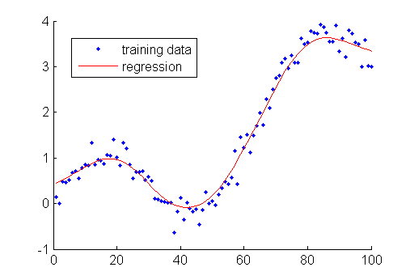
Regression: Coefficient of Determination (R² test)
Need to determine how good our regression is. Coefficient of determination R² is useful.
We would like to regress on training data, but test R² on unseen data.

Slide 4
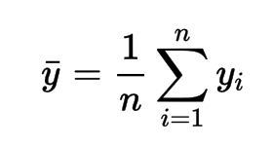

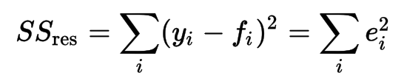
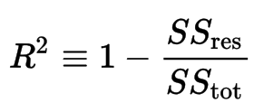
Regression: Coefficient of Determination (R² test)
SS_{res} / SS_{tot}: ratio of unexplained variance (variance of the model's errors) to the total variance (of the data):
SStot: total sum of squares
SSres: residual sum of squares

Slide 5
Regression: Coefficient of Determination (R² test)
R² closer 1 means we can predict the data well with our regression model (low variance).
0 means we have a poor model.
R² can even be negative!
If close to 1, you may have a low variance
https://en.wikipedia.org/wiki/Coefficient_of_determination

Slide 6
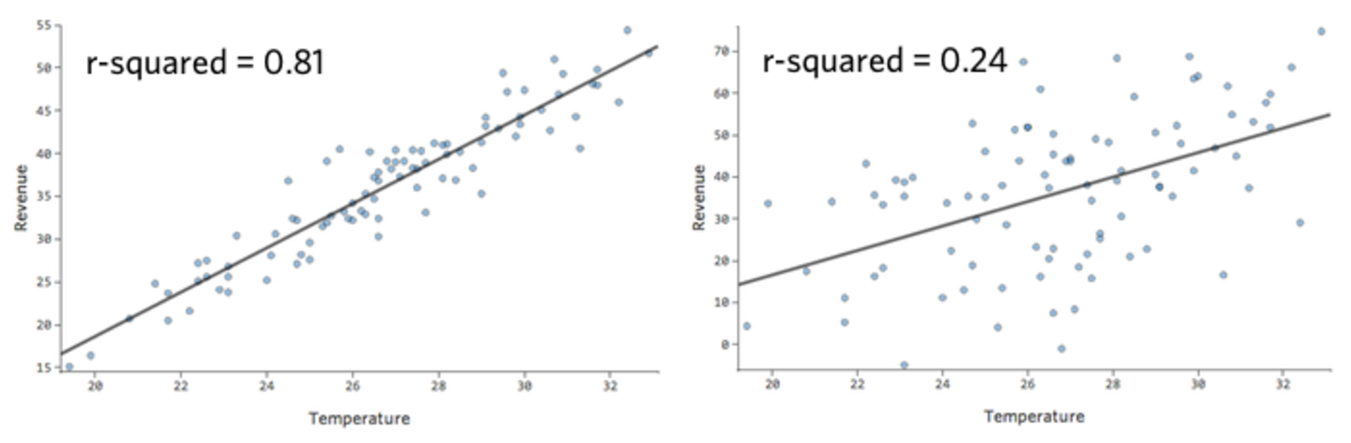
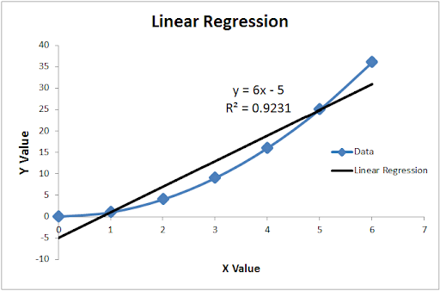
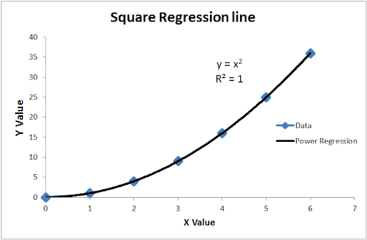
Visualizing R²
Data
Model

Slide 7
Regression: Coefficient of Determination (R² test)
As you increase the number of features, R² will continue to increase
See Kitchen Sink Regression: https://en.wikipedia.org/wiki/Kitchen_sink_regression
This gives a flawed sense of “good” model
Use adjusted R²:
Adjusted R^{2:}
http://blog.minitab.com/blog/adventures-in-statistics-2/multiple-regession-analysis-use-adjusted-r-squared-and-predicted-r-squared-to-include-the-correct-number-of-variables

Slide 8
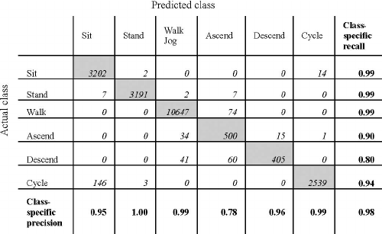
Confusion Matrix
Used in classification problems
Helps the engineer decide how well their classifier is
Numbers determined on test sets, not training

Slide 9
Confusion Matrix
Always a square matrix, not necessarily symmetric
In fact, most likely not symmetric
Ideally, a diagonal matrix

Slide 10
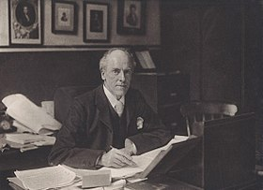
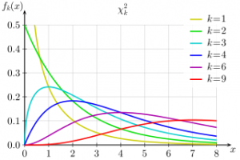
Pearson’s Chi-Square Test

Slide 11
Pearson's chi-squared test (χ2) (p-test)
There are two types of chi-square tests. Both use the chi-square statistic and distribution for different purposes:
A chi-square test for independence compares two variables in a contingency table to see if they are related. In a more general sense, it tests to see whether distributions of categorical variables differ from each another.
A chi-square goodness of fit test determines if a sample data matches a population. For more details on this type.
Notes:
contingency /kənˈtɪndʒənsi/

Slide 12
What is a Chi Square Test?
The chi-square (Ξ²) statistic compares observed and expected counts.
Observed counts are the actual number of observations of each type.
Expected counts are the number of observations that we would expect to see of each type if the null hypothesis was true.
(calculated for each category separately and then summed)
Large values for Ξ² represent strong deviations from the expected distribution under H₀, and will tend to be statistically significant.

Slide 13
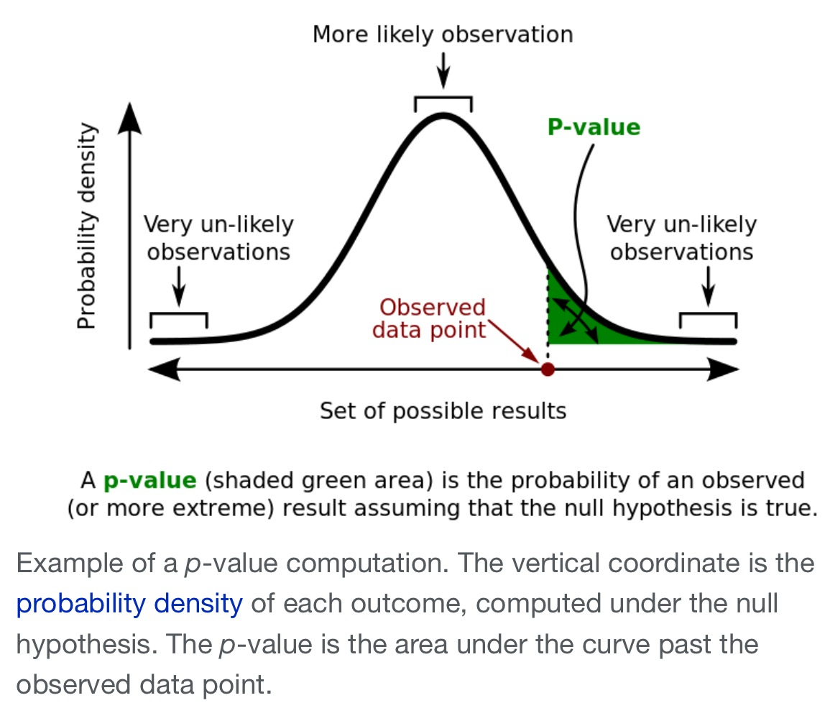
Chi Square P-Values
https://www.mathsisfun.com/data/chi-square-test.html
Notes:
the null hypothesis is a general statement or default position that there is no relationship between two measured phenomena or no association among groups.

Slide 14
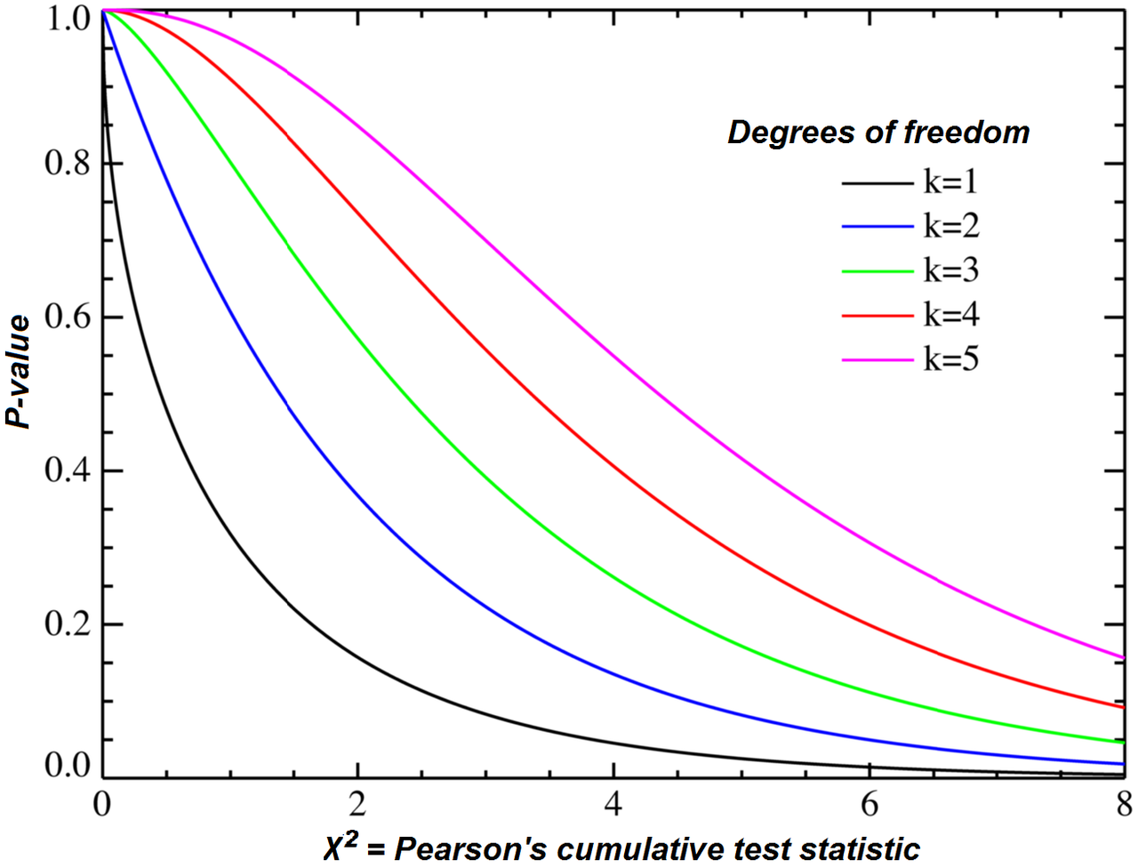
Chi-squared distribution

Slide 15
The chi-square test for Independence

Slide 16
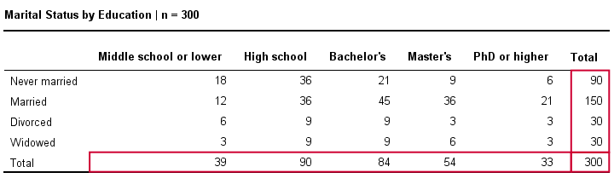
χ2 for Independence
Example: a scientist wants to know if education level and marital status are related for all people in some country. He collects data on a simple random sample of n = 300 people, part of which are shown below.

Slide 17
Step 1 Null Hypothesis
The null hypothesis for a chi-square independence test is that two categorical variables are independent in some population.
Independence means that one variable doesn't “say anything” about another variable.
Independence means that the relative frequencies of one variable are identical over all levels of some other variable.

Slide 18
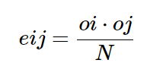
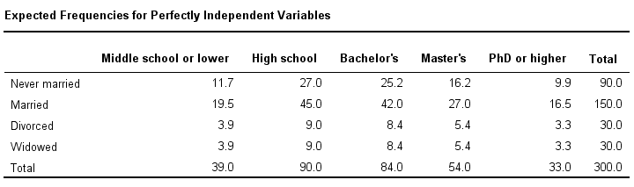

Step 2 Expected Value
$$e=90∗\frac{39}{300}=11.7$$

Slide 19
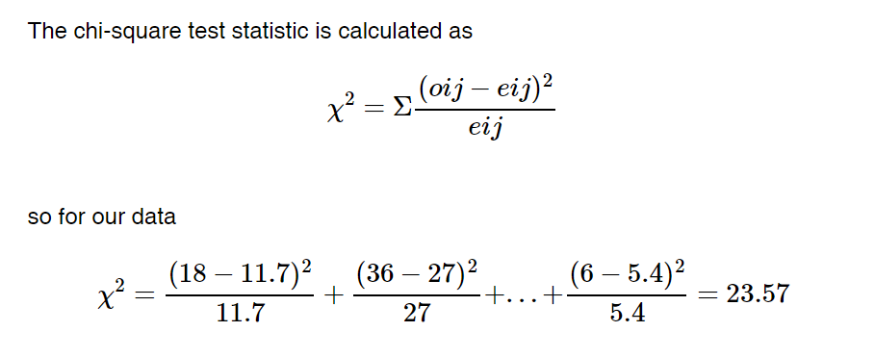
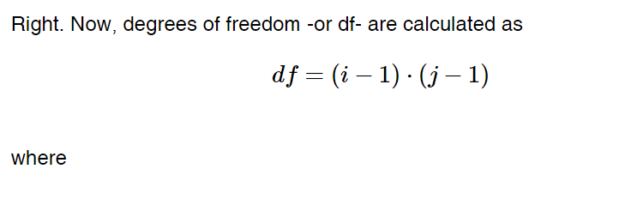
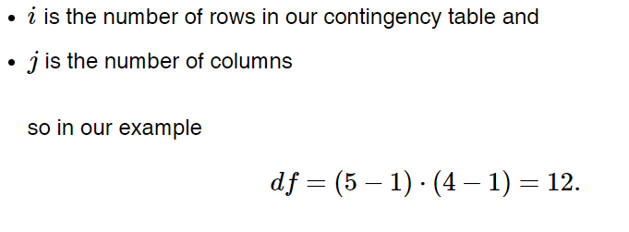
Step 3 Test Statistic

Slide 20
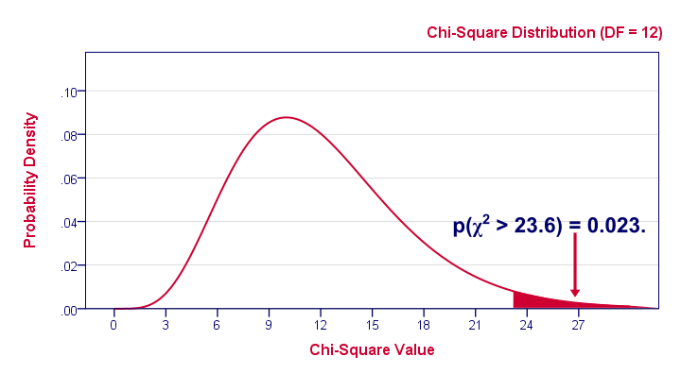
Step 4 Get P-Value

Slide 21

Table A
Ex: df = 6
If χ² = 23.57, the P-value is between 0.025 −0.02

Slide 22
Step 5 Conclusion
The conventionally accepted significance level of 0.05. If p>0.05, reject the hypothesis, else accept.
In our example, p= 0.023, accept!
The hypothesis is true at 97.7% (=1-p) that is two categorical variables are independent.
scipy.stats.chisquare(f_obs, f_exp=None, ddof=0, axis=0)[source]
https://docs.scipy.org/doc/scipy/reference/generated/scipy.stats.chisquare.html
Notes:
confidence /ˈkɑːnfɪdəns/

Slide 23
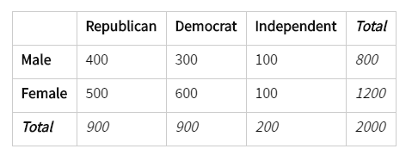
Assignment
Imagine a random poll was taken across 2,000 different voters, both male and female. The people who responded were classified by their gender and whether they were republican, democrat, or independent. Imagine a grid with the columns labeled republican, democrat, and independent, and two rows labeled male and female. Assume the data from the 2,000 respondents is as follows:
Whether the political background and gender are independent or not?

Slide 24
The chi-square test for goodness of fit

Slide 25
Idea of the chi-square test
The chi-square (Ξ²) test is used when the data are categorical. It detects differences between the observed data and what we would expect if H₀ was true.
Observed sample proportions (1 SRS of 700 births)
Expected proportions under H₀: p₁=p₂=p₃=p₄=p₅=p₆=p₇=1/7
Notes:
Again, we want to know if differences in sample proportions are likely to have occurred by chance just because of the random sampling.

Slide 26
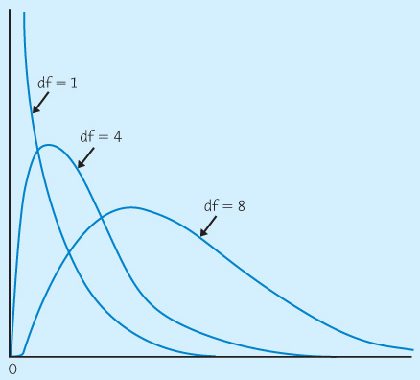
The chi-square distributions
The Ξ² distributions are a family of distributions that take only positive values, are skewed to the right, and are described by a specific degrees of freedom.
Published tables & software give the upper-tail area for critical values of many χ² distributions.

Slide 27
Table A
Ex: df = 6
If χ² = 15.9 the P-value is between 0.01 −0.02.

Slide 28
Goodness of fit hypotheses
The chi-square test can be used to for a categorical variable (1 SRS) with any number k of levels. The null hypothesis can be that all population proportions are equal (uniform hypothesis)
Are hospital births uniformly distributed in the week?
H₀: p₁ = p₂ = p₃ = p₄ = p₅ = p₆ = p₇ = 1/7
or that they are equal to some specific values, as long as the sum of all the population proportions in H₀ equals 1.
When crossing homozygote parents expressing two co-dominant phenotypes A and B, we would expect in F2
H₀: p_{A} = ¼ , p_{AB} = ½ , p_{B} = ¼ where AB is an intermediate phenotype.
Notes:
SRS: simple random samples

Slide 29
For 1 SRS of size n with k levels of a categorical variable
When testing
H₀: p₁ = p₂ = … = p_{k} (a uniform distribution)
The expected counts are all = n / k
When testing
H₀: p₁ = p_{1Ho} and p₂ = p_{2Ho} … and p_{k} = p_{kHo}
The expected counts in each level i are
expected count_{i} = n p_{iHo}
Notes:
Note: We will see in Chapter 22 that the chi-square test can also test more complex hypotheses for categorical data organized in two-way tables (looking at the relationship between two categorical variables).

Slide 30
Conditions for the goodness of fit test
The chi-square test for goodness of fit is used when we have a single SRS from a population, and the data are categorical, with k mutually exclusive levels.
The sampling distribution of the X² statistic will be approximately chi-square distributed when:
all expected counts are 1 or more (≥1)
no more than 20% of expected counts are less than 5
Notes:
There are techniques to use if the expected counts are too low: you can either collapse some levels of the categorical variable, or you can use an “exact test” (not covered in this textbook).

Slide 31
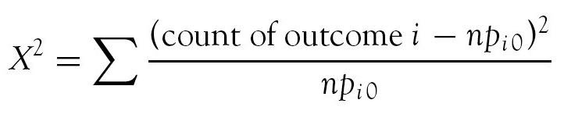
Recall:Chi-square test for goodness of fit
The chi-square statistic for goodness of fit with k proportions measures how much observed counts differ from expected counts. It follows the chi-square distribution with k − 1 degrees of freedom and has the formula:
The P-value is the tail area under the X² distribution with df = k – 1.

Slide 32

River ecology
Three species of large fish (A, B, C) that are native to a certain river have been observed to co-exist in equal proportions. A recent random sample of 300 large fish found 89 of species A, 120 of species B, and 91 of species C. Do the data provide evidence that the river’s ecosystem has been upset?
H₀: p_{A} = p_{B} = p_{C} = 1/3 H_{a}: H₀ is not true
Number of proportions compared: k = 3
All the expected counts are : n / k = 300 / 3 = 100
Degrees of freedom: (k – 1) = 3 – 1 = 2
X² calculations:

Slide 33
If H₀ was true, how likely would it be to find by chance a discrepancy between observed and expected frequencies yielding a X² value of 6.02 or greater?
From Table E, we find 5.99 < X² < 7.38, so 0.05 > P > 0.025
Software gives P-value = 0.049
Using a typical significance level of 5%, we conclude that the results are significant. We have found evidence that the 3 fish populations are not currently equally represented in this ecosystem (P < 0.05).

Slide 34
Interpreting the Ξ² output
The individual values summed in the Ξ² statistic are the Ξ² components.
When the test is statistically significant, the largest components indicate which condition(s) are most different from the expected H₀.
You can also compare the actual proportions qualitatively in a graph.
The largest X² component, 4.0, is for species B. The increase in species B contributes the most to significance.
A B C
Notes:
Note that some software programs also call the chi-square components “chi-square contributions.” They give a measure of the relative disparity between observed and expected counts for each condition.

Slide 35
Lack of significance: Avoid a logical fallacy
A non-significant P-value is not conclusive: H₀ could be true, or not.
This is particularly relevant in the X² goodness of fit test where we are often interested in H₀ that the data fit a particular model.
A significant P-value suggests that the data do not follow that model (but by how much?).
But finding a non-significant P-value is NOT a validation of the null hypothesis and does NOT suggest that the data do follow the hypothesized model. It only shows that the data are not inconsistent with the model.
Notes:
Model comparison is better approach. Finding the best fit models.

Slide 36


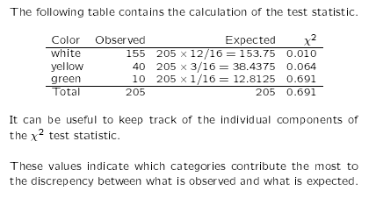
Goodness of fit for a genetic model
Under a genetic model of dominant epistasis, a cross of white and yellow summer squash will yield white, yellow, and green squash with probabilities 12/16, 3/16 and 1/16 respectively (expected ratios 12:3:1).
Suppose we observe the following data:
Are they consistent with the genetic model?
H₀: p_{white} = 12/16; p_{yellow} = 3/16; p_{green} = 1/16
H_{a}: H₀ is not true
We use H₀ to compute the expected counts for each squash type.
Notes:
Notice how the three proportions in the null hypothesis add up to 1.
Notice how the three expected counts add up to the sample size 205.

Slide 37
We then compute the chi-square statistic:
Degrees of freedom = k – 1 = 2, and X² = 0.691.
Using Table D we find P > 0.25. Software gives P = 0.708.
This is not significant and we fail to reject H₀. The observed data are consistent with a dominant epistatic genetic model (12:3:1). The small observed deviations from the model could simply have arisen from the random sampling process alone.

